Slide 1
Learn2Write
Learn2Write is an interactive learning tool designed to evaluate Penmanship skills using a trained computer model.

Slide 2
Objective
The objective is to train the model using the images of the hand written alphabets and numbers enough so that it predicts the handwritten character LIVE.
Our PROJECT has many applications including teaching young children and those who are new to English as well as those using physical therapy to regain mobility and hone their writing skills after injury or stroke. Additionally future builds will be able to evaluate lower case letters, beginning letter sounds, text to speech, cloud deployment, more user friendly GUI and more!

Slide 3
Challenges
The input dataset should be available and large enough to be trained for real time handwritten characters.
Choice of the machine learning model.
Our system should support the processing of large/big data.

Slide 4
Input TRAIN & TEST Data
The EMNIST dataset is a set of handwritten character digits derived from the NIST Special Database 19 and converted to a 28x28 pixel image format and dataset structure that directly matches the MNIST dataset.
Formats:
CSV file format - .csv & supporting .txt
Binary file format - idx
Matlab format - .mat (First 116 bytes for timestamp).

Slide 5
Dataset Summary
There are six different splits provided in this dataset. A short summary of the dataset is provided below:
EMNIST ByClass: 814,255 characters. 62 unbalanced classes([0-9],[a-z] and [A-Z]).
EMNIST ByMerge: 814,255 characters. 47 unbalanced classes.
EMNIST Balanced: 131,600 characters. 47 balanced classes - set of characters with an equal number of samples per class
EMNIST Letters: 145,600 characters. 26 balanced classes - a balanced set of the uppercase and lowercase letters into a single 26-class task
EMNIST Digits: 280,000 characters. 10 balanced classes - balanced handwritten digit datasets directly compatible with the original MNIST dataset
EMNIST MNIST: 70,000 characters. 10 balanced classes - balanced handwritten digit datasets directly compatible with the original MNIST dataset

Slide 6
Factors affecting model selection
Kind of problem – Multiclass Classification Problem
Data is present in “Tabular” format
Data is stored as “Image”

Slide 7
Model selection
Multilayer Perceptron - MLPs are suitable for classification prediction problems where inputs are assigned a class or label.
MLPs are used for:
Tabular dataset, Classification or Regression prediction problems
Convolutional Neural Network - CNNs, were designed to map image data to an output variable.
CNNs are used for:
Image data, Classification or Regression prediction problems
Recurrent Neural Network - RNNs, were designed to work with sequence prediction problems.
Recurrent neural networks are not appropriate for tabular datasets as you would see in a CSV file or spreadsheet. They are also not appropriate for image data input.
Don’t Use RNNs For:
Tabular data
Image data

Slide 8
Additional Factors – Loss function
Categorical_crossentropy – We were dealing with classes so chose this.
Here the targets should be in categorical format. So, if we have 10 classes, the target for each sample should be a 10-dimensional vector that is all-zeros except for a 1 at the index corresponding to the class of the sample.
In order to convert integer targets into categorical targets, you can use the Keras utility ”to_categorical”.
from keras.utils import to_categorical categorical_labels = to_categorical(int_labels, num_classes=None)

Slide 9
Additional Factors - Choice of optimizers
Gradient Descent, Adam, Adagrad, Adadelta, RMS Prop and Momentum.
Chose ADAM for it learns the fastest. It is more stable than the other optimizers, it doesn’t suffer any major decreases in accuracy.
Adam is an optimization algorithm that can used instead of the classical stochastic gradient descent procedure to update network weights iterative based in training data.
In our case, Adagrad, Adadelta & RMS Prop were average performers.

Slide 10
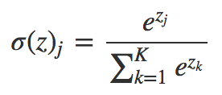
Additional Factors – Activation function
The activation function of a node defines the output of that node, or "neuron," given an input or set of inputs. This output is then used as input for the next node and so on until a desired solution to the original problem is found.
Indentity, Binary Step, Logistic/Sigmoid, Tanh, ArcTan, Rectified Linear Unit(Relu), Leaky Relu, Softmax
Relu f(x) = 0, if x < 0 and f(x) = x, if x =>0. Removes the negative part
Softmax – finding out the most probable occurrence.
The output of the softmax function is equivalent to a categorical probability distribution, it tells you the probability that any of the classes are true.

Slide 11
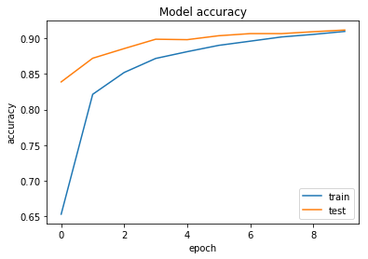
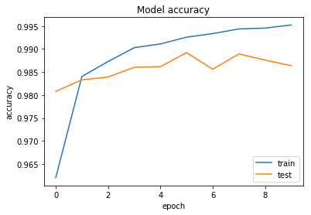
Accuracy – With Multilayer Perceptron
Letters - Test accuracy: 89.4385% Test loss: 32.9096%
25/26=96.2% (True 25 False 1)
Digits - Test accuracy: 98.8850% Test loss: 3.9529%
14/15=93.3% (True 14 False 1)

Slide 12
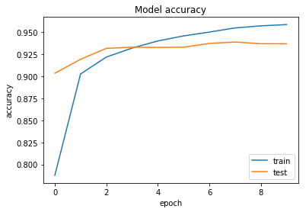
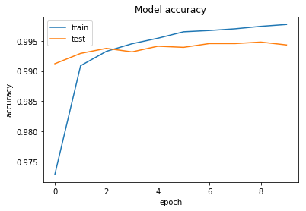
Accuracy – With Convolutional Neural NW
Letters - Test accuracy: 92.2157% Test loss: 23.9659%
26/26=100 % (True 26 False 0)
71/72=98.6 % (True 71 False 1)
Digits - Test accuracy: 99.4550% Test loss: 1.9149%
15/15=100 % (True 15 False 0)
68/72=94.4 % (True 68 False 4)

Slide 13
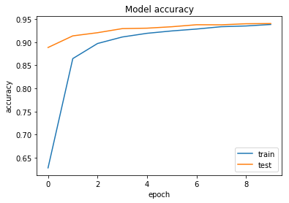
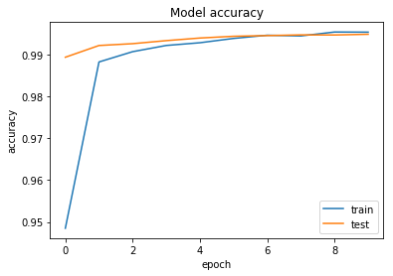
Accuracy – With Parallel Convolutional Neural NW
Letters - Test accuracy: 92.8238% Test loss: 21.9858%
26/26=100 % (True 26 False 0)
Digits - Test accuracy: 99.4550% Test loss: 1.9149%
15/15=100 % (True 15 False 0)

Slide 14
Project demo

Slide 15
Learn2Write Team
Jill Stratton – Front End
Pragati Mehta – Machine learning
Alfia Fahrutdinova - Database
Saswati Mahapatra - Miscellaneous

Slide 16
Vote of Thanks
Ashish Nachane – Approving the concept
Aiyana Liz Mathew – Helping with preprocessing of the images
Mario Aburto – Helping with “Painterro” GUI testing
Jonathan Groth – Helping with CNN parallel model architecture
Deepa Karnani – General discussion (SGD)

Slide 17
References
https://www.nist.gov/itl/iad/image-group/emnist-dataset
https://machinelearningmastery.com/when-to-use-mlp-cnn-and-rnn-neural-networks/
https://www.w3schools.com/html/html_filepaths.asp
https://keras.io/getting-started/sequential-model-guide/
https://keras.io/layers/convolutional/
https://keras.io/losses/
https://keras.io/layers/pooling/
https://medium.com/octavian-ai/which-optimizer-and-learning-rate-should-i-use-for-deep-learning-5acb418f9b2
https://en.wikipedia.org/wiki/Activation_function
https://elitedatascience.com/overfitting-in-machine-learning
https://github.com/Kulbear/deep-learning-nano-foundation/wiki/ReLU-and-Softmax-Activation-Functions
https://en.wikipedia.org/wiki/Activation_function

Slide 18
Questions?

